Slide 1
Data Management for Analytics Project Using Web Scraping from Estimize.com
EstiAmaze Teens !!!
Bharath Badri Venkata
Vaishnavi Mada
Srujani Mareddy

Slide 2
Problem Statement and Tools Used
Database Design
Data Scraping
Regression Analysis
Query Analysis
Estimize Highlights
Workflow
AGENDA

Slide 3
Problem Statement:
Scrape Data
Extract comprehensive data for 29 stock tickers from Estimize.com, covering 2020,2021,2022 years across four quarters.
Data Storage
Develop structured datasets to systematically store scraped information, encompassing EPS data, Company details, and Analyst insights.
Database Creation
Construct a robust database leveraging the generated datasets, facilitating seamless queries to extract accurate and relevant information.

Slide 4



Tools Used
Served as the primary programming language for scripting, orchestrating the entire web scraping process.
Integrated to establish a connection with a MySQL database for storing and querying data.
Created database to store the scraped EPS, company, and analyst information.
Allows interaction with web elements to access diverse information on stock estimates, analyst details, and company profiles.
Utilized for browser automation to navigate through Estimize.com and extract data dynamically.

Slide 5




Key Highlights of Estimize
Open financial estimates platform launched in 2011.
Aggregates estimates from independent, buy-side, sell-side analysts, private investors, and students.
Boasts contributions from 97,439 users for stock price estimates.
Covers over 2,200 stocks, providing insights into diverse market segments.
Includes estimates for 80 economic indicators each quarter, expanding analysis beyond individual stocks.

Slide 6
Data Acquisition
Utilize Selenium for automated web scraping of unstructured data from Estimize.com.
Data Storage in JSON/CSV format
Store the scraped data into a json or csv format.
Importing Data - MYSQL
Creating a MySQL database and table schema matching the structure of the scraped data.
Querying Data - MYSQL
Use techniques to capture data from various web elements, transforming unstructured data into a usable format.
Making it ready for easy querying.
SQL queries to retrieve and analyze the imported data
Dump the data in the CSV file to MYSQL workbench using sqlalchemy and urllib.parse libraries in python
Workflow

Slide 7

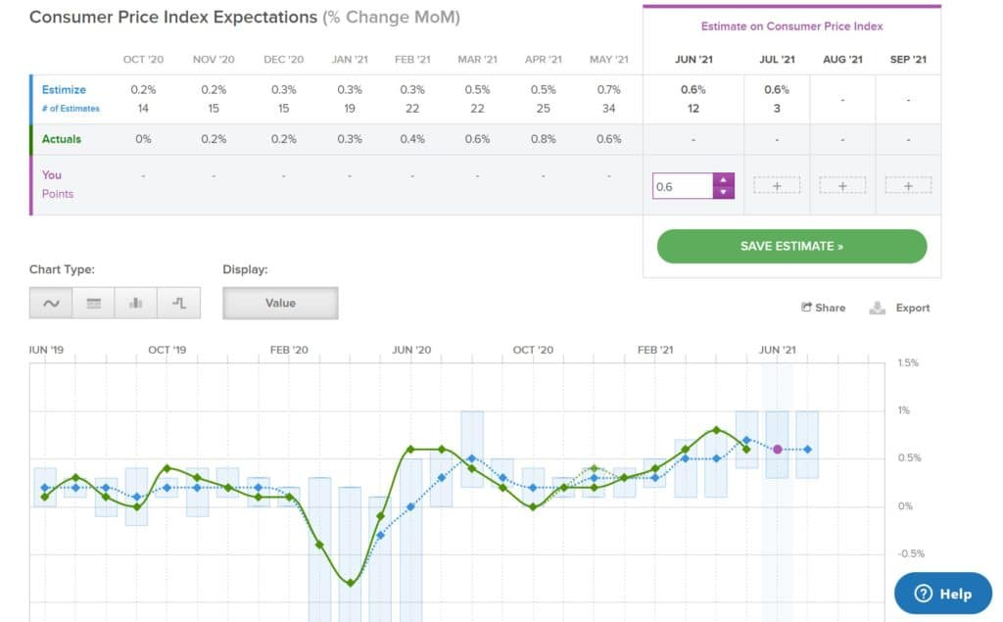

Data Scraping

Slide 8
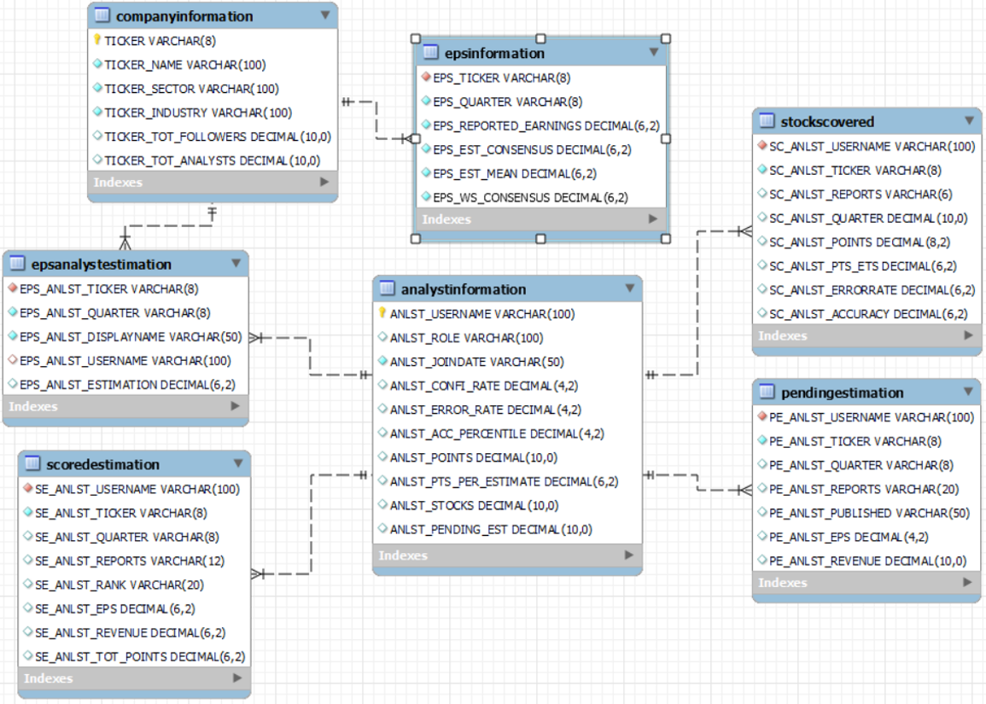
Database Design

Slide 9
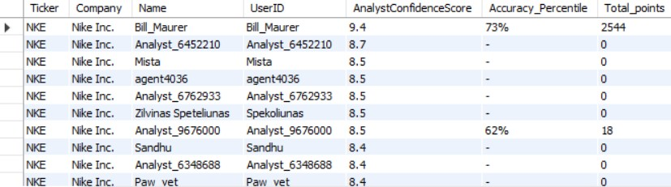
Query Analysis
Given a ticker, how many analysts have made estimations for its EPS? Rank them by their confidence score, total points, error rate or accuracy percentile?
SELECT E.Ticker, E.Company, E.Name, A.UserID, A.AnalystConfidenceScore, A.Accuracy_Percentile, SUM(A.Points) as Total_points FROM epsdata E INNER JOIN analystinfodata A ON E.Name = A.Name WHERE E.Ticker = 'NKE' GROUP BY E.Ticker, E.Company, E.Name, A.UserID, A.AnalystConfidenceScore, A.Accuracy_Percentile ORDER BY A.AnalystConfidenceScore DESC, Total_points, A.Accuracy_Percentile;
1

Slide 10
Given a industry, how many companies are covered, the average number of analysts, the average bias between the Estimize Consensus and the Reported Earnings?
SSELECT count(distinct(C.Ticker_BI)) as Num_Companies, avg(Ticker_NumAnalysts) as Avg_Analysts, avg(E.ReportedEarnings_EPS + E.EstConsensus_EPS)/2 as Avg_bias, Ticker_Industries FROM company_details C INNER JOIN eps_data E on C.Ticker_BI = E.Ticker_EPS WHERE C.Ticker_Industries = 'Food & Staples Retailing' GROUP BY C.Ticker_Industries;
2

Slide 11
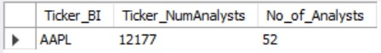
Which company have the largest number of analysts with confidence score greater than 7?
SELECT DISTINCT C.Ticker_BI, C.Ticker_NumAnalysts, COUNT(I.AnalystUserName) AS No_of_Analysts FROM company_details C INNER JOIN analyst_eps P ON C.Ticker_BI = P.Ticker_AE INNER JOIN analyst_data I ON P.AnalystSecondaryName_AE = I.AnalystUserName WHERE I.AnalystConfidenceRate > 7 GROUP BY C.Ticker_BI, C.Ticker_NumAnalysts ORDER BY C.Ticker_NumAnalysts DESC LIMIT 1;
3

Slide 12
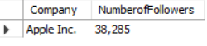
Who has the largest number of followers?
SELECT Ticker_BI FROM company_details WHERE Ticker_numFollowers = (SELECT MAX(Ticker_numFollowers) FROM company_details);
4

Slide 13
Regression Analysis
ETL
Data Preprocessing
Linear Regression
Accuracy: 79.7%
One Hot Encoding

Slide 14
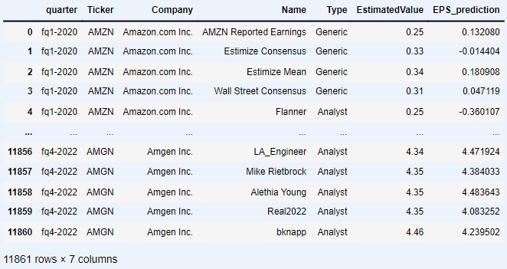

Slide 15
Questions

